Slide 1
Predicting Credit Card Defaulters: A Machine Learning Approach
Group-5
Adithya Kale
Sai Teja Gunamouni
Hema Pushpika
Vamshi Konapuram
Ananth Mohan

Slide 2
Problem Statement
Predicting whether a customer is defaulting credit payment for the next month
The findings of the project aim to assist financial institutions by addressing the below:
1) Risk Management:
- To proactively reduce credit limits of users based on their profile and mitigate losses.
2) Customer Retention:
- Retaining customers by providing tailored incentives to low-risk customers using
customer segmentation.

Slide 3
About Dataset
This dataset contains information on default payments, demographic factors, credit data, history of payment, and bill statements of credit card clients
Source: https://archive.ics.uci.edu/ml/datasets/default+of+credit+card+clients
UCI Machine learning repository
The dataset has over 30,000 observations and 24 features.

Slide 4
Dataset Description
Features:
LIMIT_BAL: continuous. Credit Limit of the person.
SEX: Categorical: 1 = male; 2 = female
EDUCATION: Categorical: 1 = graduate school; 2 = university; 3 = high school; 4 = others
MARRIAGE: 1 = married; 2 = single; 3 = others
AGE: num. continuous.
PAY_0,PAY_2 to PAY_6: Categorical :-
-2: Payment made in full and on time
-1: payment made in full but past the due date , 0: payment of the minimum amount was made
1: payment amount less than the minimum amount due
2: payment amount is between the minimum amount due and the full amount due
3: payment amount is between one and two months late
4: payment amount is between two and three months late
5: payment amount is between three and four months late
6: payment amount is between four and five months late
7: payment amount is between five and six months late
8: payment amount is between six and seven months (or more) late.
BILL_AMT1 to BILL_AMT6: Amount of bill statements.
PAY_AMT1 to PAY_AMT6: Amount of previous payments
Target:
Default Categorical
0:The Person will not be in the defaulter list for the next month
1: The Person will be in the defaulter list for the next month

Slide 5
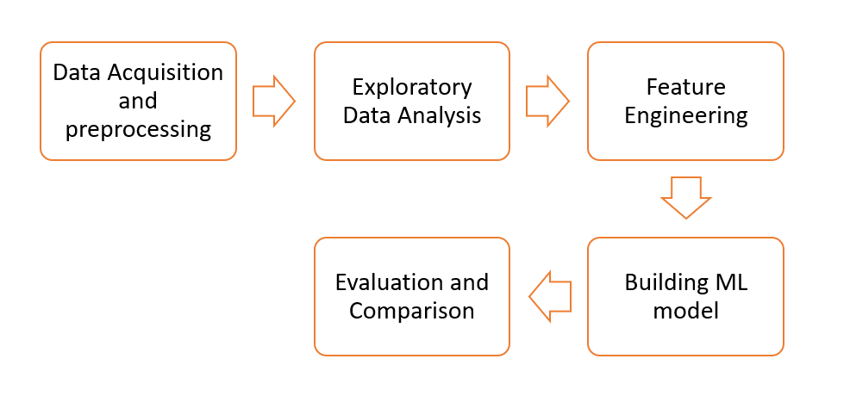
Flow Chart

Slide 6
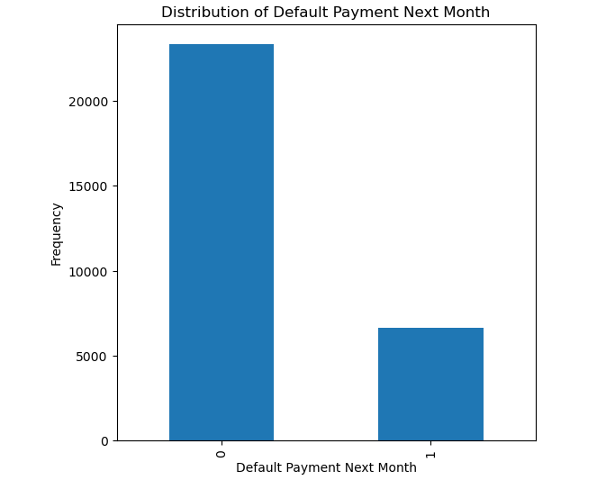
EXPLORATORY DATA ANALYSIS
The plot shows the distribution of default Payment showing unbalanced class:
Class 0 – has 23364 non-defaulters (Max)
Class 1 – has 6636 defaulters (Min)

Slide 7
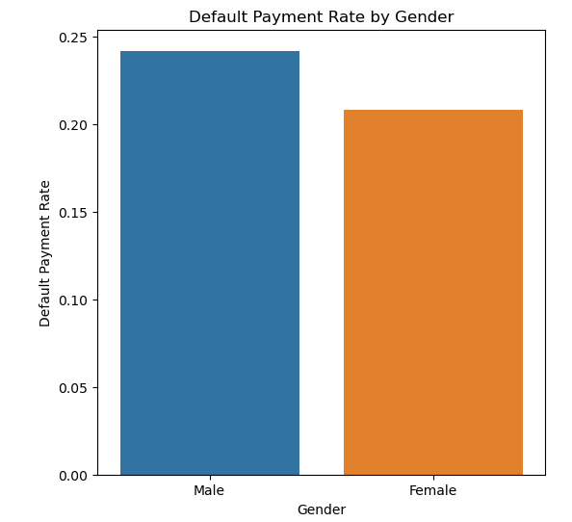
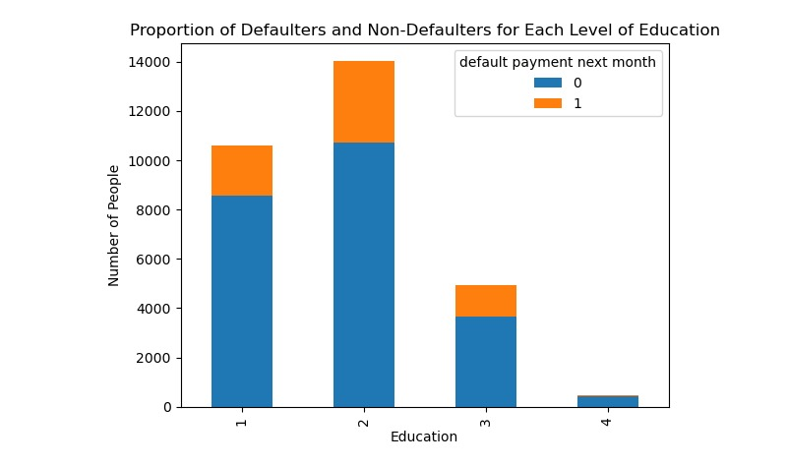
Plot shows the default payment distribution of both Gender and Education categories
Gender Category plot indicates non defaulters are high in males.
Education Category plot indicates that University students contribute to max defaulters.
(1 = Graduate School; 2 = University; 3 = High School;
4 = Others)

Slide 8
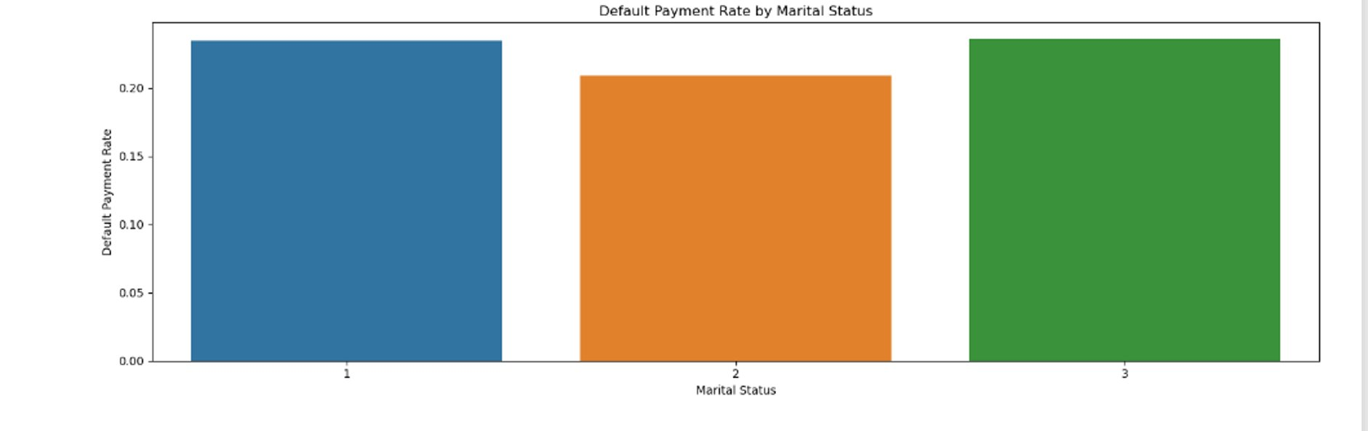
Default payment rate by marital status:
From this visualization , divorced or widowed category has the highest default rate. But there not that significant difference (1 = Married; 2 = Single; 3 = Others)

Slide 9
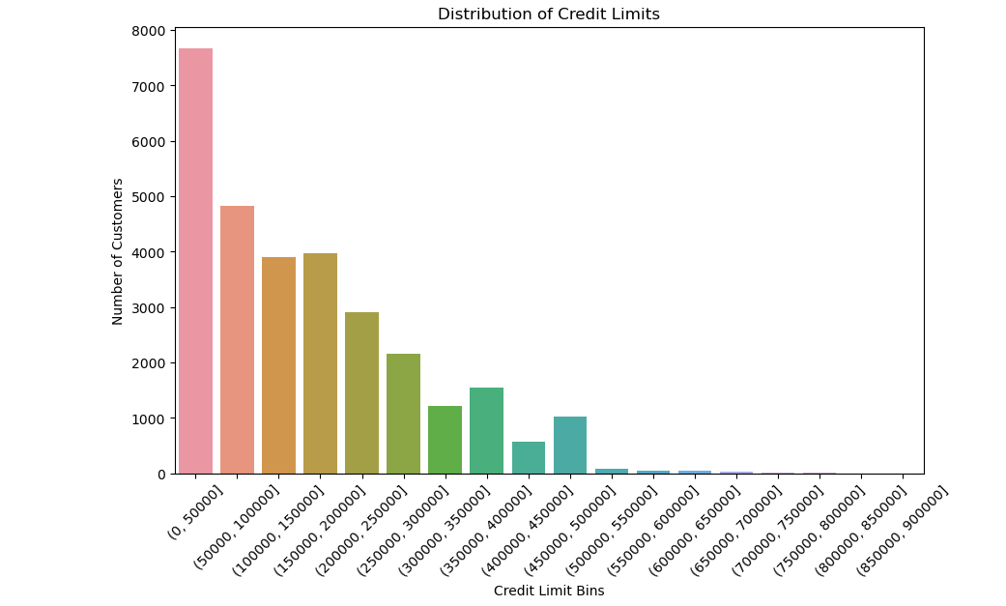
Distribution of credit limits (LIMIT_BAL) among the customers?
It can be clearly seen that majority of the people fall under the credit limit of 300000 where majorly people fall in basic credit limit that is (0-50000)

Slide 10
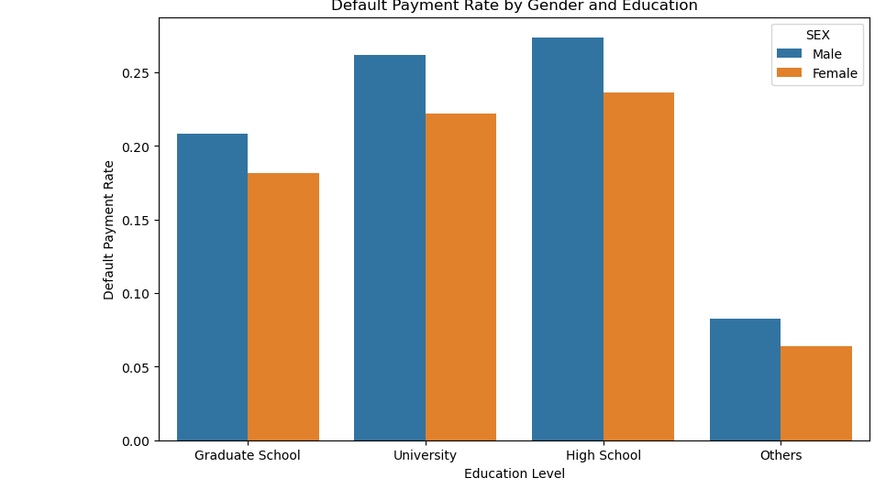
How does the distribution of default payments vary across different genders, education levels
The most number of default payments are recorded from university and high school students

Slide 11
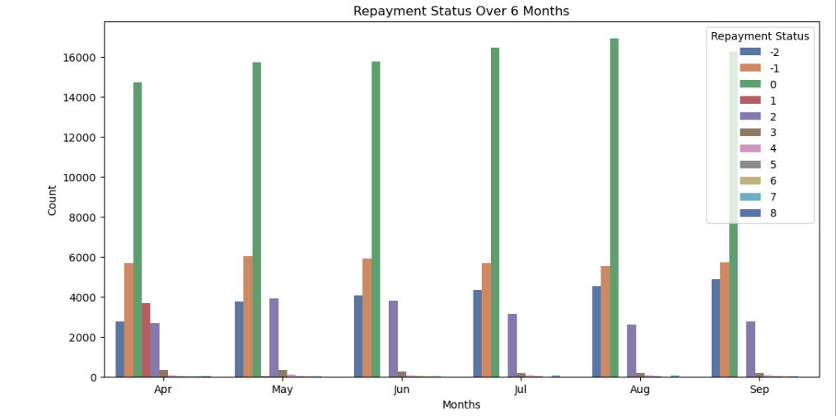
How do the repayment statuses (PAY_1 to PAY_6) vary over the six months?
It can be clearly interpreted that many people choose to pay their minimum amount every month. And the point that is to be noted is there are good number of people who pay full amount on time.
There are good number of people who are not paying the minimum amount but they are attempting to pay.

Slide 12
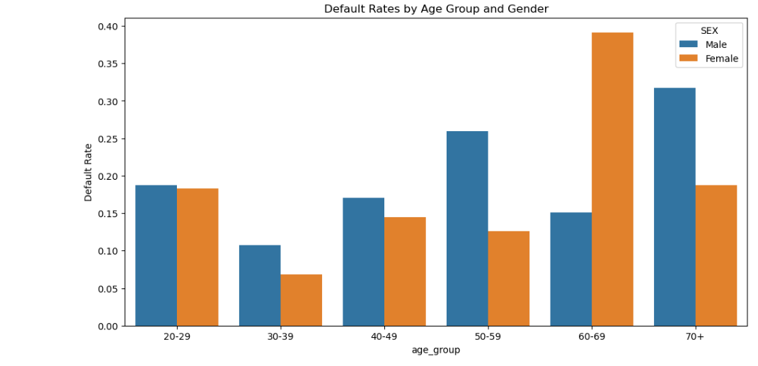
How does the distribution of default payments vary across different genders, Age Groups
From the plot it can be inferred that most of the credit card defaulters are above 50 both in males and females.
This is so because of lack of knowledge about the credit cards.

Slide 13
Feature Engineering
Split dataset into train and test subsets (70:30)
Sampling training data
SMOTE(Synthetic Minority Oversampling Technique)
Oversampling
Undersampling

Slide 14
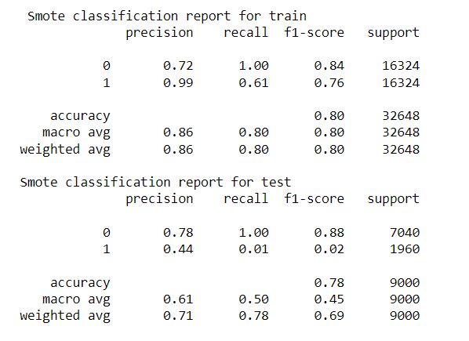
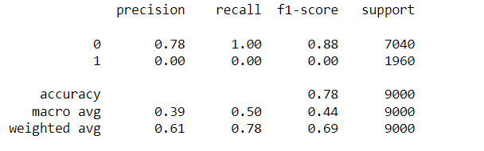
Logistic Regression
The model using SMOTE to balance the data achieved an accuracy of 80% on the training set and 78% on the test set. However, the precision, recall, and F1-score for the minority class (class 1) were much lower than the majority class (class 0) in both training and test sets.

Slide 15
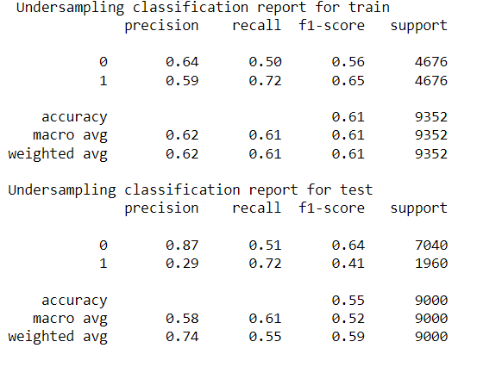
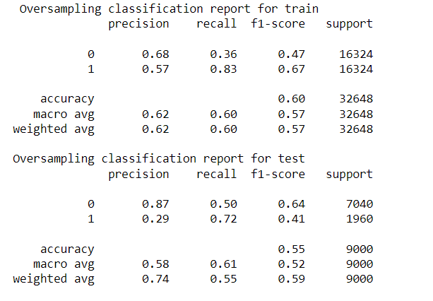
Logistic Regression
The oversampling method results in higher recall for the minority class in both train and test sets compared to SMOTE, but lower precision for the minority class. The overall accuracy is lower for the oversampling method compared to SMOTE.
In undersampling, the precision and recall for the minority class (class 1) is higher than in oversampling, but the overall accuracy is lower. The F1-score is also lower compared to SMOTE.
The model using SMOTE to balance the data achieved an accuracy of 80% on the training set and 78% on the test set. However, the precision, recall, and F1-score for the minority class (class 1) were much lower than the majority class (class 0) in both training and test sets.

Slide 16
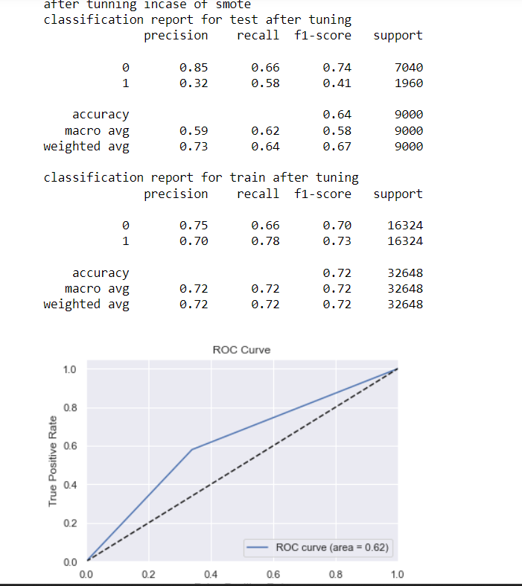
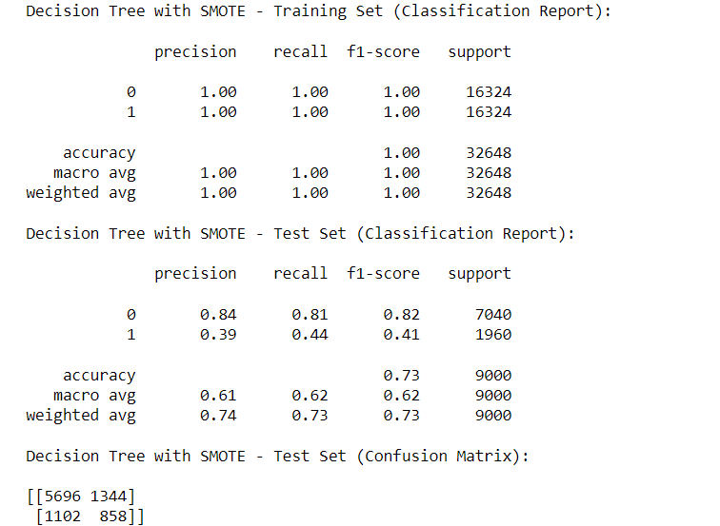
Decision Tree Classifier
After tuning hyperparameters
SMOTE works by selecting a minority class example and generating synthetic samples by interpolating between this example and its nearest neighbors. This helps to increase the number of minority class instances and create a more balanced training dataset.
The decision tree model with have performed well on the training set, achieving perfect precision, recall, and f1-score for both classes but on the test set, the model has lower performance, with lower precision, recall, and f1-score for the minority class. However, the overall accuracy of 0.73 is still reasonable.
After tuning, the Smote sampling technique shows improved performance on the training set with an accuracy of 0.72 and an f1-score of 0.73 for the minority class. However, the performance on the test set is not very good with an accuracy of 0.64 and an f1-score of 0.41 for the minority class.

Slide 17
Conclusion
Despite efforts to address class imbalance through sampling techniques and hyperparameter tuning, the logistic regression model still faces challenges in accurately predicting the minority class.
While SMOTE sampling improved the performance metrics for the minority class on the training set, its effectiveness did not generalize well to the test set, indicating potential issues with model generalization.
Further exploration of advanced sampling techniques, ensemble methods, or alternative classification algorithms may be necessary to improve the model's performance on the minority class and enhance its overall predictive accuracy.
Algorithm | Train Accuracy | Test Accuracy
Logistic Regression | 72 | 64
Support Vector Machine
K-Nearest Neighbors
Decision Tree
Random Forest
RNN

